Slide 1
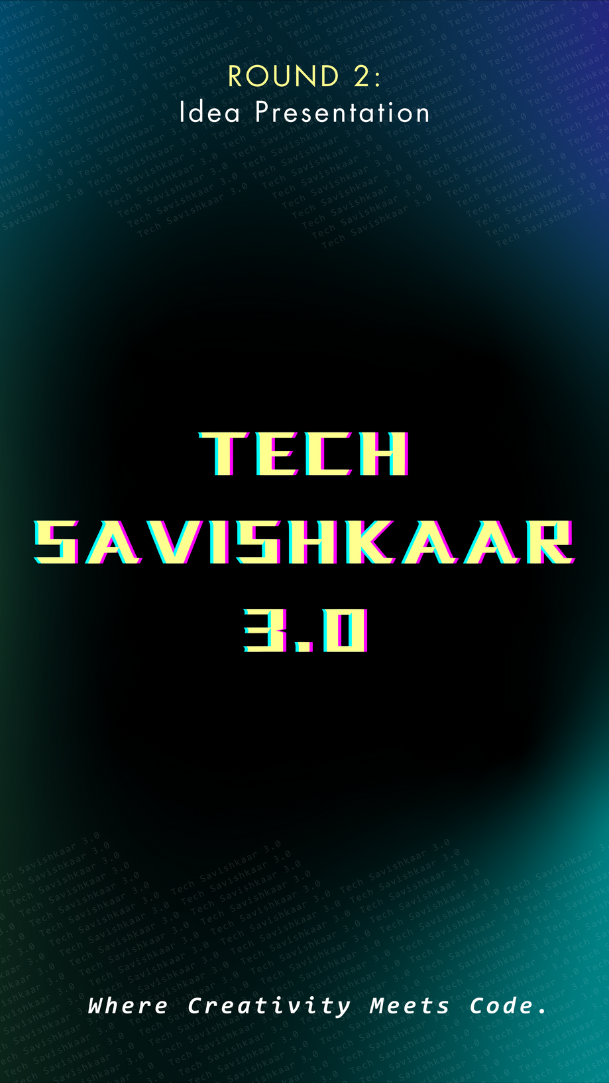


VASAVI COLLEGE OF ENGINEERING
(Autonomous)
Ibrahimbagh,Hyderabad - 500031
Accredited by NAAC with A++ Grade
DEPARTMENT OF INFORMATION TECHNOLOGY
In association with:

Slide 2
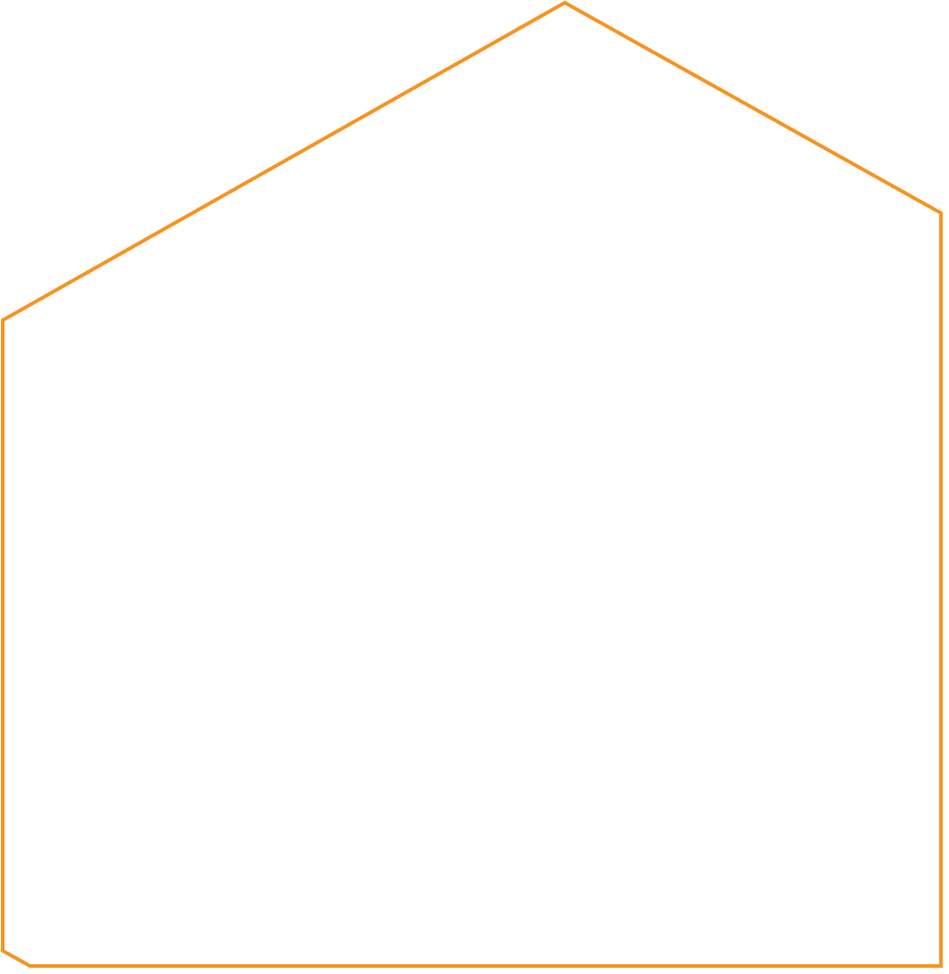
IDEA TITLE
Team ID: UR563Q9K
Branch & Year: IT &3rd
Institution:Vasavi College Of Engineering
Location:Hyderabad
Domain: Healthcare
Problem Statement : Healthcare professionals often face significant communication barriers when conducting medical camps in different villages or cities. Variations in local accents, dialects, and languages make it difficult for doctors to accurately understand patients' symptoms and medical history. Additionally, critical medical information may be lost or misinterpreted, leading to potential misdiagnoses and ineffective treatment. To address this challenge, we propose the development of an AI-driven Speech Recognition System tailored for healthcare settings
Tech Savishkaar 3.0

Slide 3
ABOUT YOUR IDEA
When doctors visit remote villages or different cities for medical camps, they often face language and accent barriers that make communication difficult. Patients may speak in local dialects or regional accents that are not easily understood by the doctors. This leads to:
Misinterpretation of symptoms and medical history.
Incorrect diagnoses due to communication gaps.
Delays in treatment and improper prescriptions.
Difficulty in maintaining accurate patient records.
To bridge this communication gap, we propose a Speech Recognition System that can accurately transcribe, translate, and interpret patient speech into a language that doctors understand, ensuring effective and accurate medical care.
3
Tech Savishkaar 3.0

Slide 4
USE CASES
TECH STACK
Patient Consultation Assistance
Doctors can use the system to transcribe and translate patient speech in real-time.
Multi-Language Medical Camps
In areas where people speak multiple languages, the system can act as a bridge between doctors and patients.
Medication & Treatment Guidance
Doctors can dictate prescriptions or treatment plans, and the system can translate them into the patient’s native language.
Medication & Treatment Guidance
Doctors can dictate prescriptions or treatment plans, and the system can translate them into the patient’s native language.
Elderly & Illiterate Patient Support
Many elderly or illiterate patients may struggle with written communication.
Frontend (User Interface for Doctors & Patients)
Framework: HTML , CSS , JavaScript
Backend (Processing & API Management)
Framework: Node.js (Express.js)
Database: MongoDB
Speech Recognition & NLP
Google Speech-to-Text API
Natural Language Processing (NLP) & Translation
:Google Cloud Natural Language
OpenAI GPT (for contextual understanding)
Machine Learning & Model Training
Programming Language: Python
Frameworks: TensorFlow
4
Tech Savishkaar 3.0

Slide 5
OPTIONAL - UNIQUE VALUE PROPOSITION
Our AI-powered Speech Recognition System is designed specifically for medical camps in diverse linguistic regions, addressing challenges that existing general-purpose speech recognition tools fail to solve.
Unlike standard speech-to-text solutions that struggle with regional accents and dialects, our system is trained on localized speech datasets.
Supports multiple languages and dialects, enabling seamless communication between doctors and patients.
This solution bridges the communication gap between doctors and patients in diverse linguistic settings. By combining speech recognition, NLP, and medical AI, we enable accurate, real-time understanding, ensuring better healthcare delivery in remote and underserved areas
5
Tech Savishkaar 3.0

Slide 6
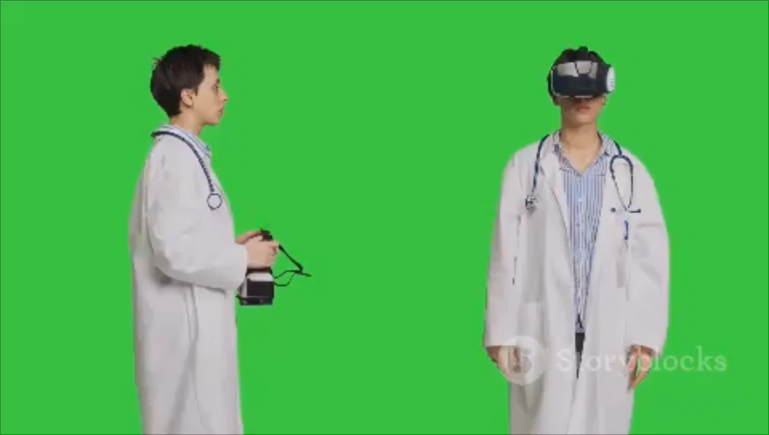
VIDEO EXPLANATION
6
Tech Savishkaar 3.0

Slide 7


TEAM DETAILS
Team Leader: R Vinoothna
Branch: IT Year:3rd
Team Member 1: Trivendar Reddy
Branch: CSE Year:2nd
Team Member 2: P.Maharshi Revanth
Branch: IT Year:3rd
Team Member 3: B.Shrestha
Branch:IT Year:3rd
Team Member 4:
Branch: Year:
7
Tech Savishkaar 3.0

